Slide 1
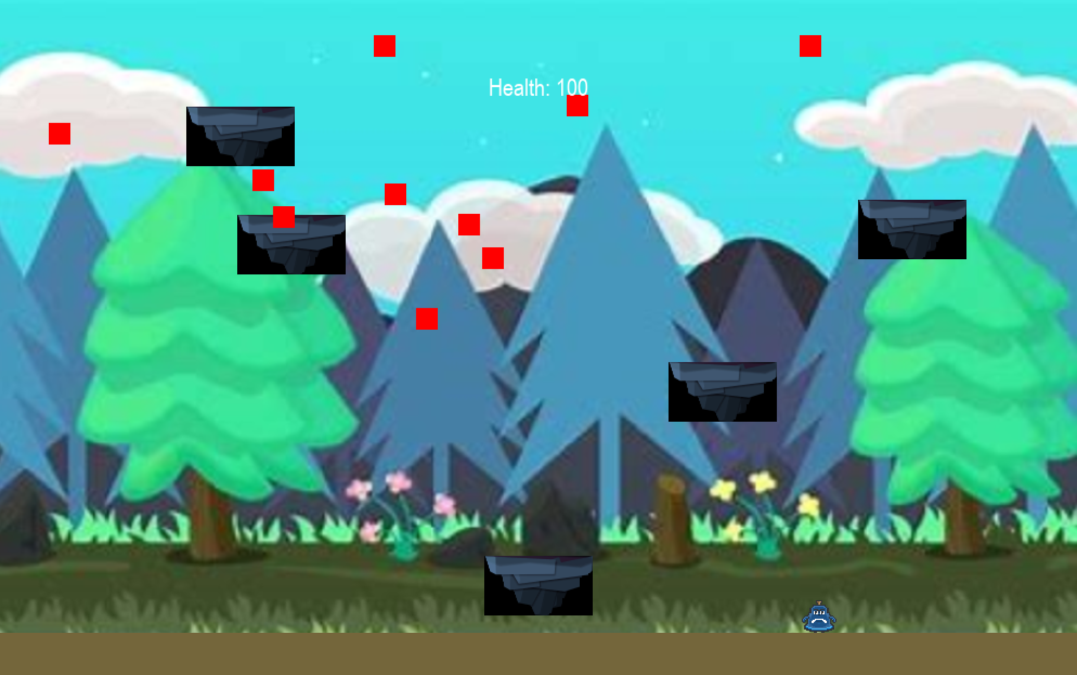

Bellarun
Carlos and Louis

Slide 2
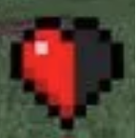
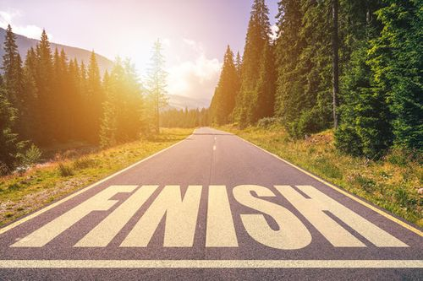
GOALS
Random Mob Generation:
Mobs deal 1 hit of damage to the player.
Adds dynamic challenge and engagement.
Mob movement logic attempted but not yet functional
Background Scroll:
Background image re-pastes itself down the screen.
Creates a scrolling loop for a visually dynamic experience.
Background Class: Manages the background, allowing it to scroll based on the player's velocity.
Finish-line
Clear endpoint for player progression.
Signifies completion of the game level.

Slide 3

Big Problem to Solve
Issue:
Integration of images caused significant disruption to the original code structure
Original code became impractical for handling visual elements and images would not assign to the right classes
Resolution:
Introduced specialized classes for visual elements:
"PlatformBase" Class:
Base class for platforms, supporting different types
"Platform" Class:
Represents solid platforms using a rock image
"Fplatform" Class:
Represents a special ground platform using a solid color
"Background" Class:
Manages the background, facilitating scrolling
Impact:
Improved modularity and readability
Streamlined handling of various visual components

Slide 4
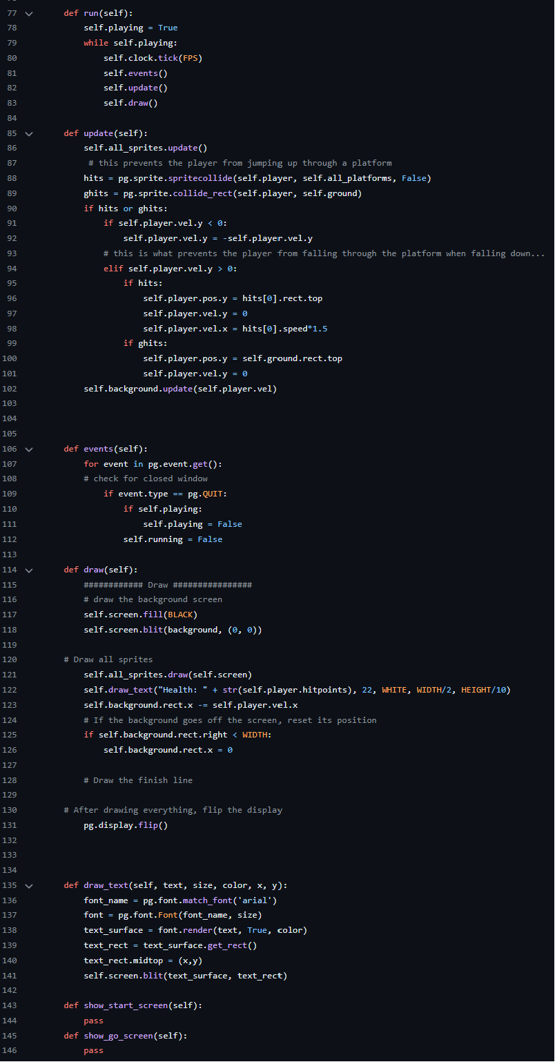
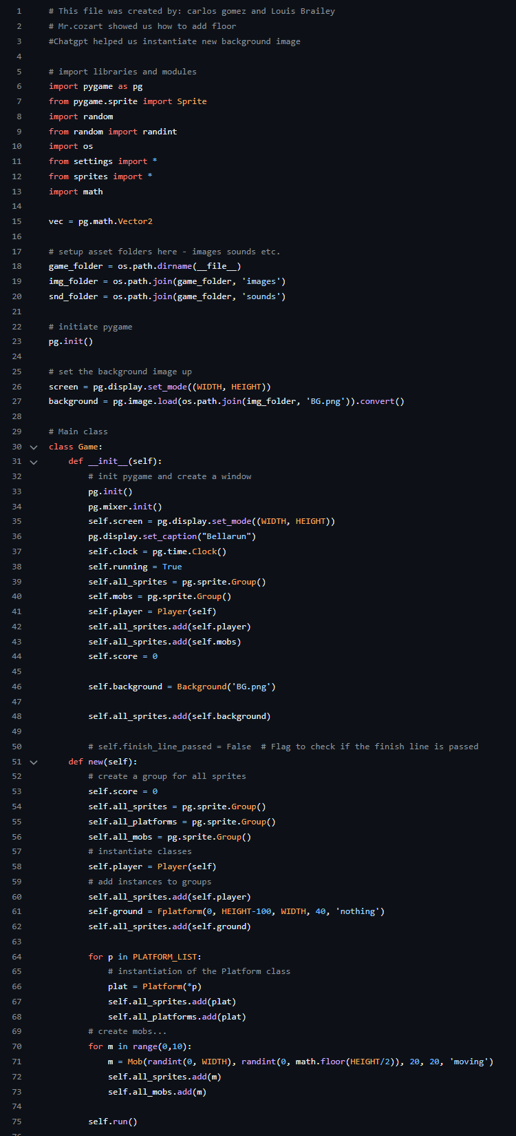
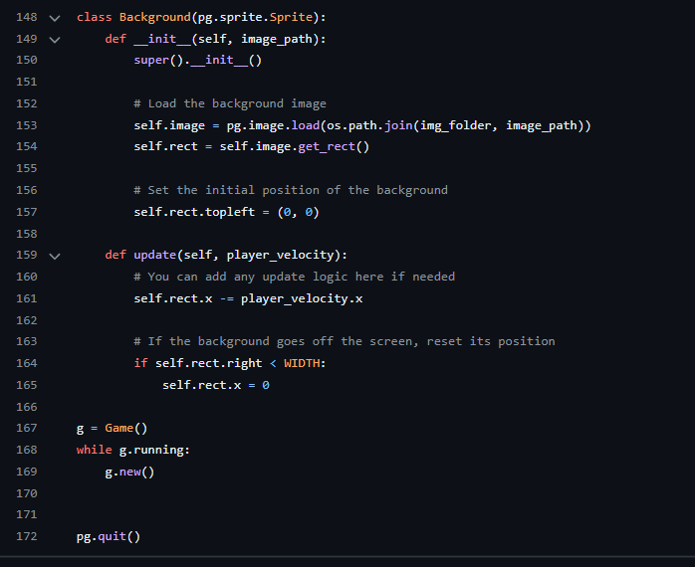
Screenshot – main.py
Notes:
Chat said update the draw method in the Game class to blit the background image before drawing other sprites

Slide 5
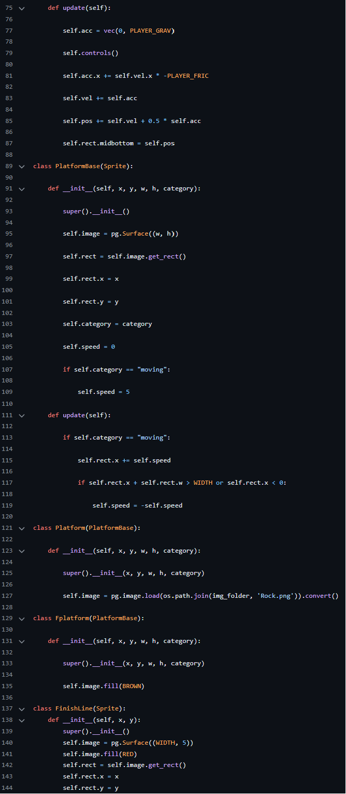
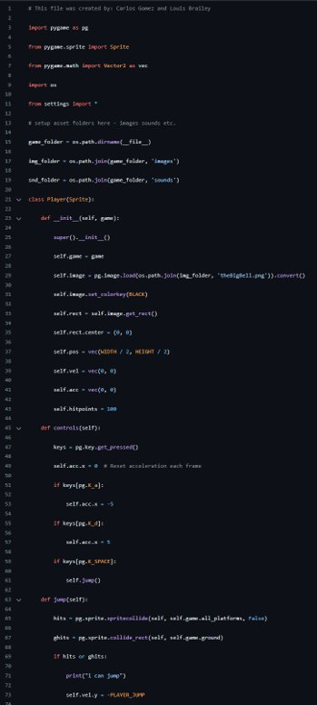
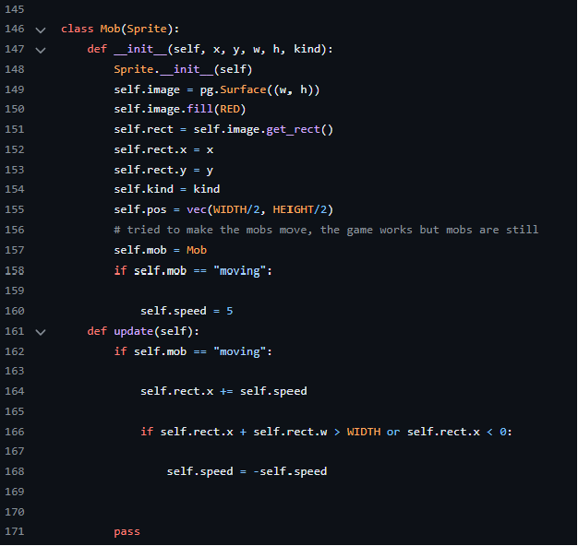
Screenshot – sprites.py

